Slide 1


Predicting Stroke Risk
Analyzing Key Factors and Building a Robust Model

Slide 2

Table of Contents
Project Outline
Methodology and Tools
Data Preparation and Analysis
Recommendations
App and Dashboard
Predicting Stroke Risk
Analyzing Key Factors and Building a Robust Model

Slide 3




Predicting Stroke Risk
 | Project Outline |  | Methodology & Tools |  | Data Preparation & Analysis |  | Recommendations |  | App & Dashboard
Stroke is the 2nd leading cause of death globally, responsible for approximately 11% of total deaths.
- World Health Organization (WHO) -
Key Factor
Diagnosis
Business
Facilitation
Early Prediction
Our project aims to identify critical factors contributing to stroke and build a predictive model. Our final goal is to develop an application to monitor at-risk individuals to help them maintain good health and prevent stroke-related complications.

Slide 4







Data Analysis Methodology and Tools
 | Project Outline |  | Methodology & Tools |  | Data Preparation & Analysis |  | Recommendations |  | App & Dashboard
Data Source |  | EDA and Modeling |  | Prototyping |  | Dashboard
The data source used for this project is Kaggle. |  | All of the data cleaning, exploratory data analysis, feature engineering and modeling process is done in Jupyter notebook using Python. |  | Microsoft Powerpoint is used to create a mockup for the Heart Stroke Prediction Application. |  | KPI, Metrics, and other visualizations to analyze the Heart Stroke case are built in Tableau.

Slide 5
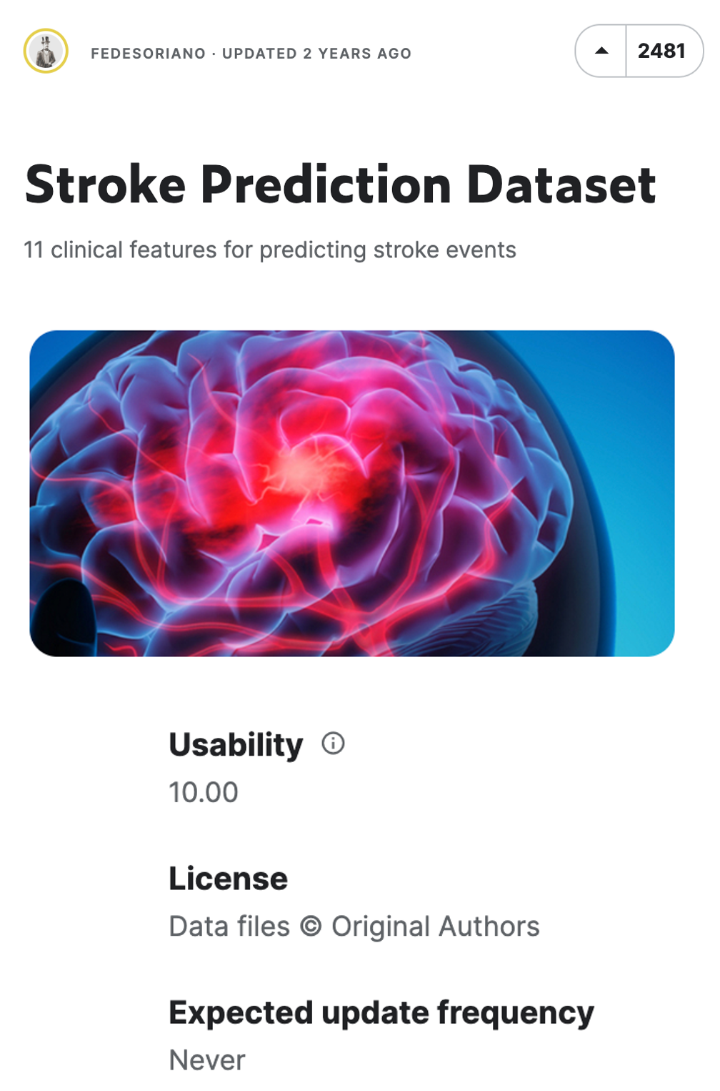
Data Description
 | Project Outline |  | Methodology & Tools |  | Data Preparation & Analysis |  | Recommendations |  | App & Dashboard
 | Stroke Prediction Dataset*
Topic | 11 clinical features for predicting stroke events
Observations | 5,110 observations
Variables | 12 variables
 | id, gender, age, hypertension, heart_disease, ever_married, work_type, Residence_type, avg_glucose_level, bmi, smoking_status, and stroke
Variable Types | Categorical variables (e.g., gender), Binary variable (e.g., ever_married), and numeric variables (e.g.,age)
Null Values | Some missing values exist due to patients' unwillingness to provide their personal data and such missing values need to be handled before EDA
*https://www.kaggle.com/datasets/fedesoriano/stroke-prediction-dataset

Slide 6
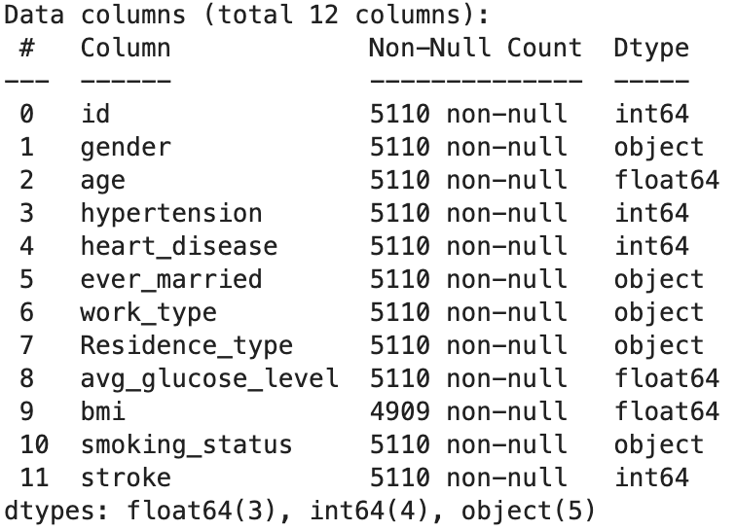
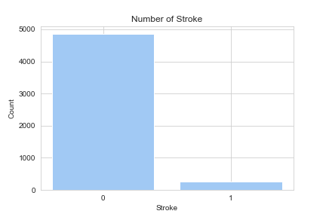
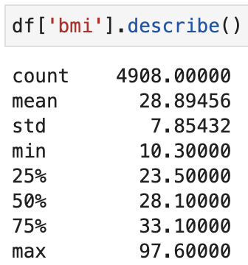
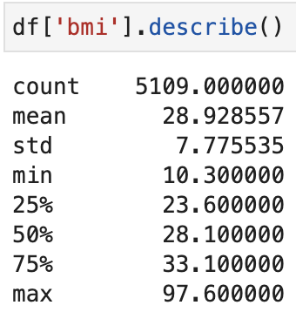
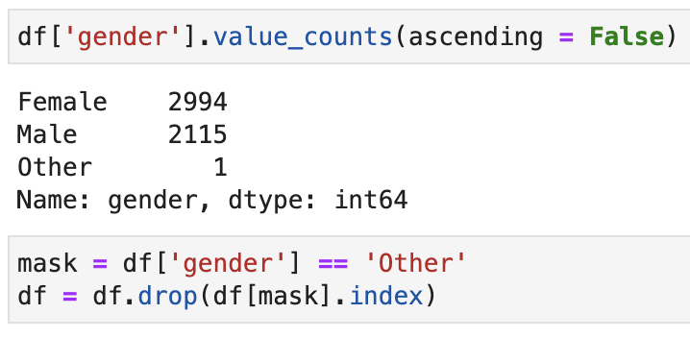
Data Preparation
 | Project Outline |  | Methodology & Tools |  | Data Preparation & Analysis |  | Recommendations |  | App & Dashboard
Data Type
We categorize our features as either categorical or numerical variables and adjust their data types accordingly.
Data Structure
Our target variable has binary outcomes. The values are highly imbalanced and we may need to upsample the data in the future.
Null Values
In the BMI feature, approximately 4% of the data is missing(201/5,110). To impute these missing values, we will use the .interpolate() function.
Outliers and Null Values
Since there is only one observation in the gender variable categorized as 'other', we will simply drop this observation.

Slide 7
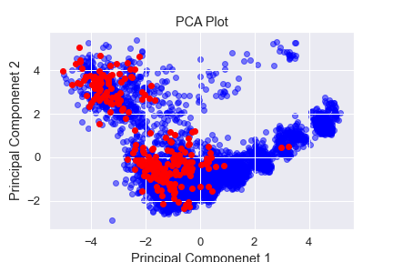
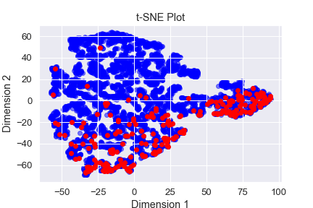
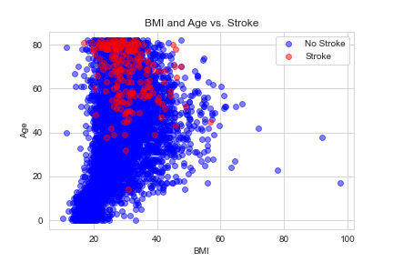
Data Visualization through Dimensionality Reduction
 | Project Outline |  | Methodology & Tools |  | Data Preparation & Analysis |  | Recommendations |  | App & Dashboard
How will our data be represented in 2 dimensions
after we use dimensionality reduction techniques to compress our 11 features?
PCA (Principal Component Analysis)
From the PCA plot, we can understand the relationships within the data in the reduced-dimensional space while retaining as much of the original variability as possible.
t-SNE (t-Distributed Stochastic Neighbor Embedding)
The clusters that are closely grouped together by t-SNE in the 2 dimension represent subgroups of the data that share similar characteristics or features in the higher dimensions.
Global Similarity
Local Similarity
captures the most variation in the data

Slide 8
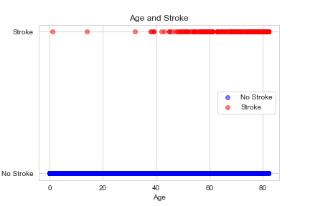
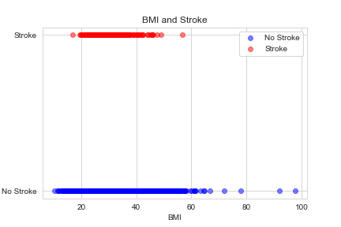
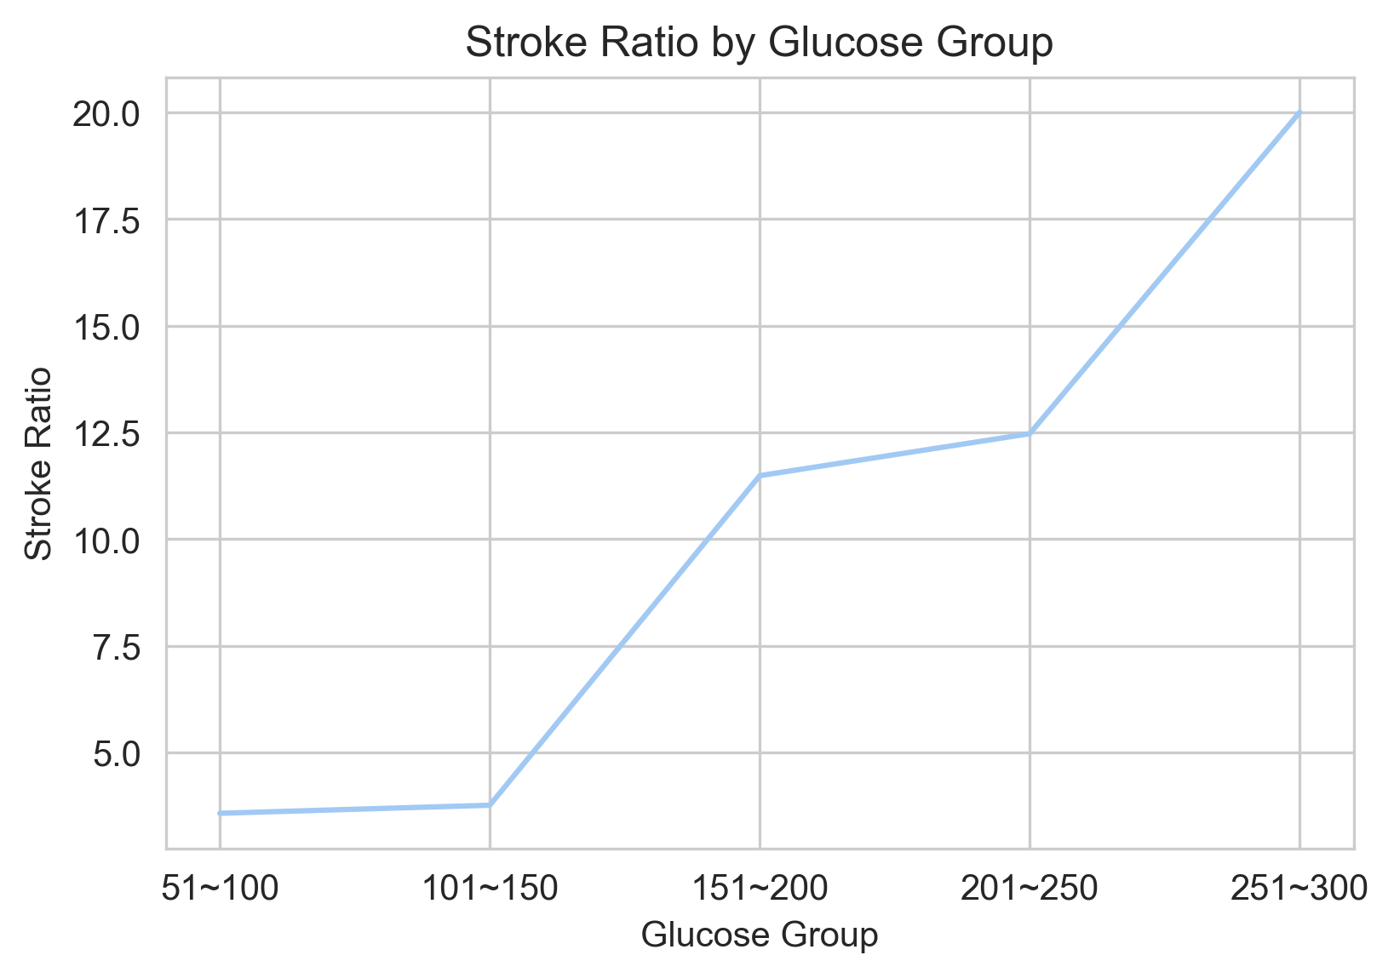
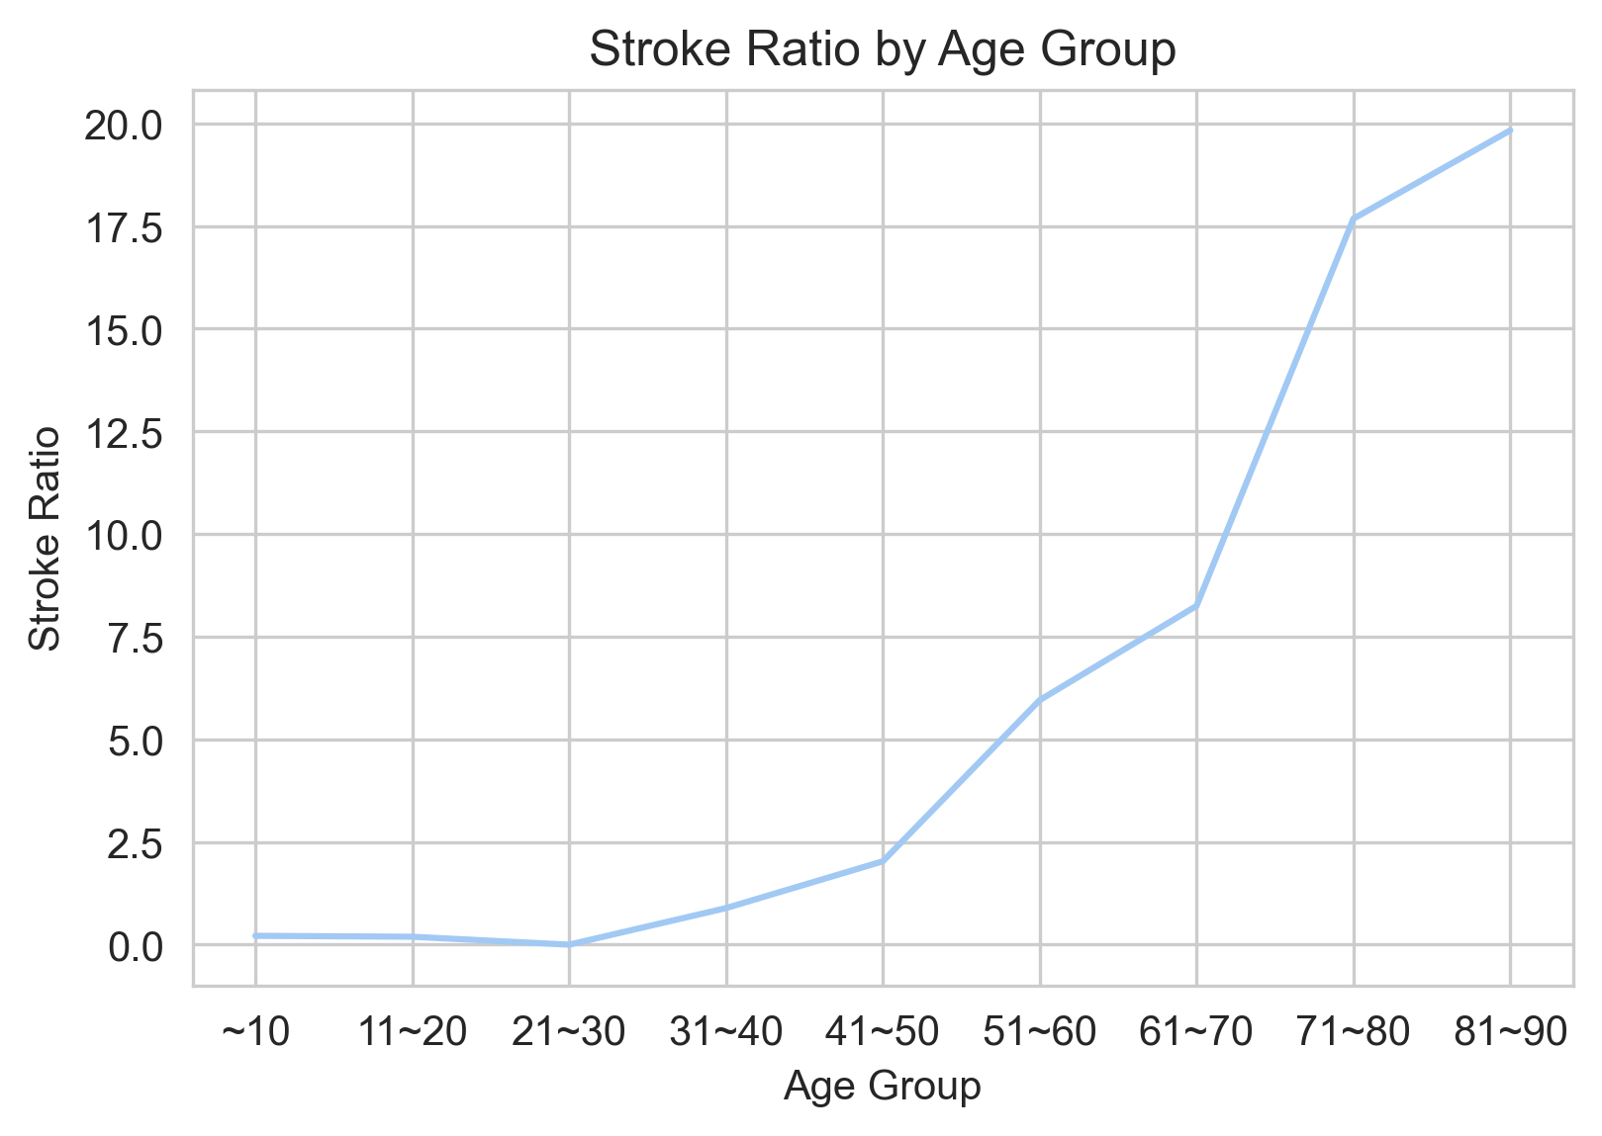
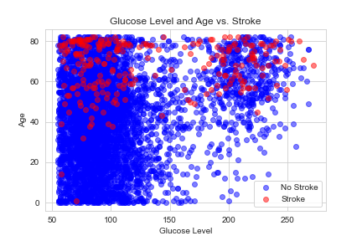
Exploratory Data Analysis: Numerical Variables
 | Project Outline |  | Methodology & Tools |  | Data Preparation & Analysis |  | Recommendations |  | App & Dashboard
Age
The risk of stroke increases rapidly after the age of 40, and significantly rises after the age of 60.
BMI* (Body Mass Index)
Having a BMI over 25(overweight or obese) raises the likelihood of stroke, with obesity after 60 years old being a notable contributing factor.
Glucose Level
Elevated glucose levels exceeding 200 indicate diabetes, and when coupled with advanced age, may constitute a crucial risk factor for stroke.
*BMI = kg/m^2

Slide 9
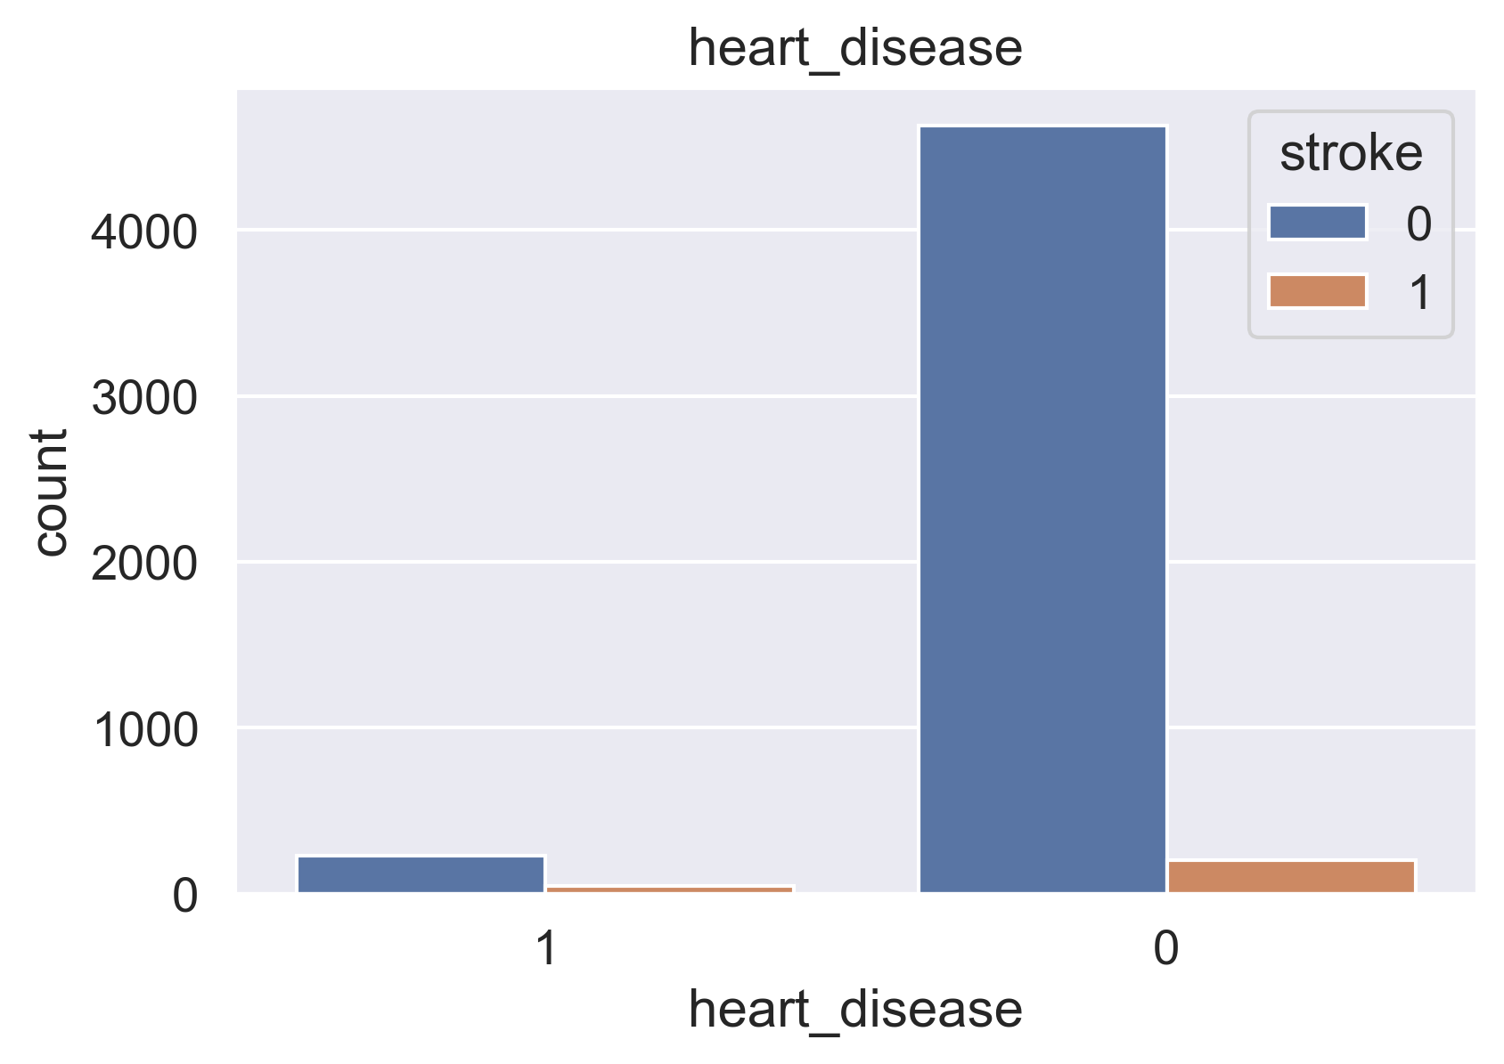
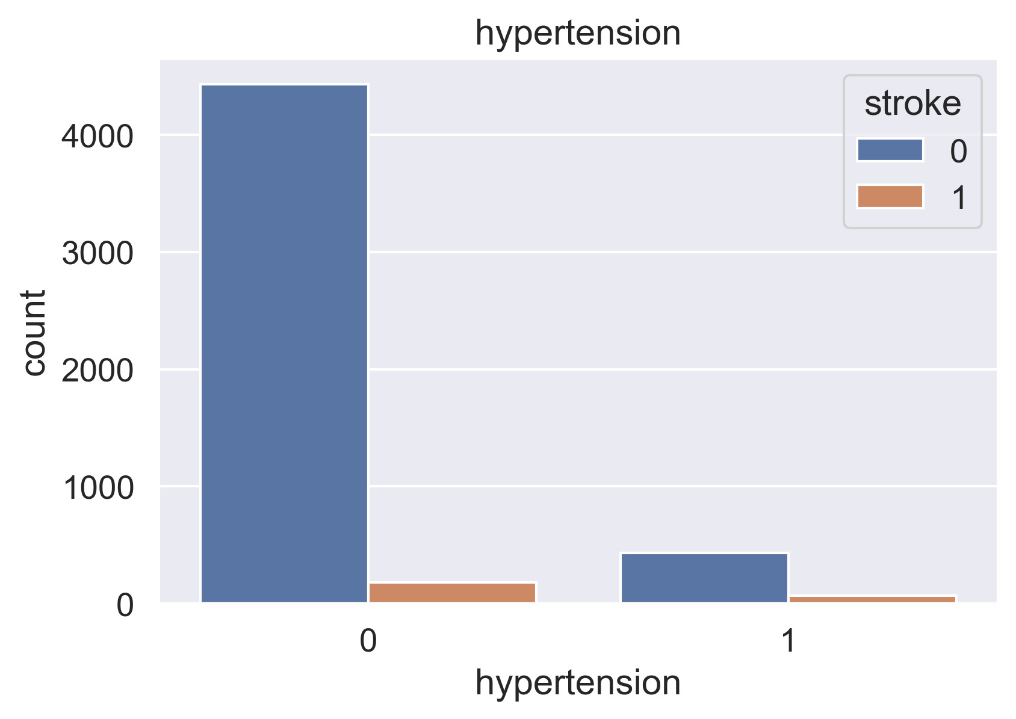
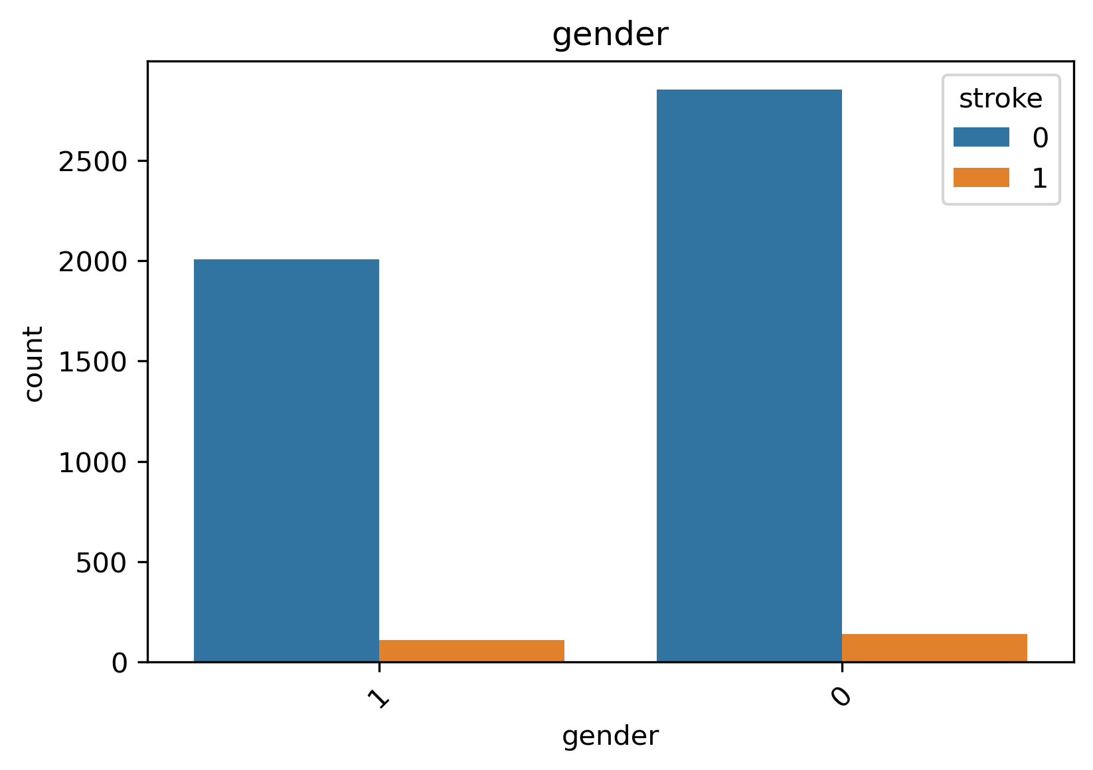
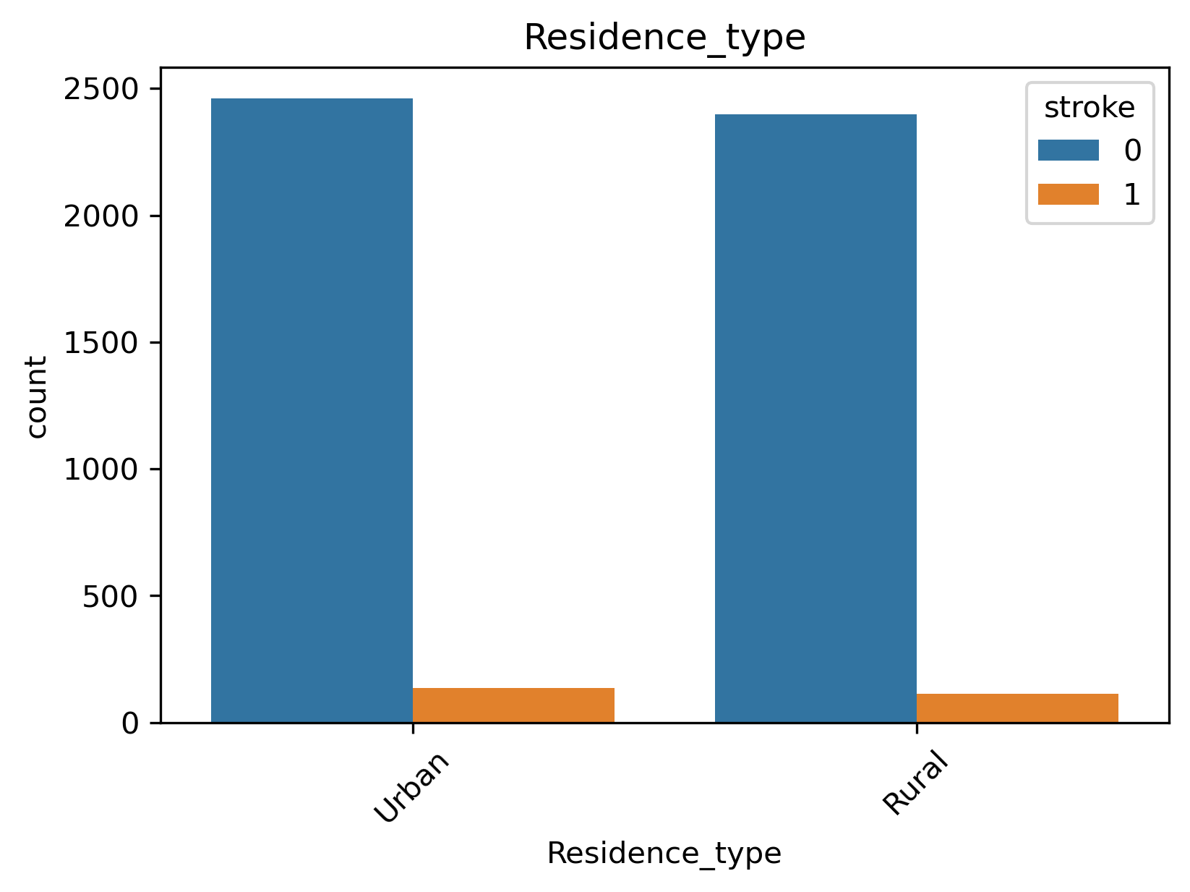
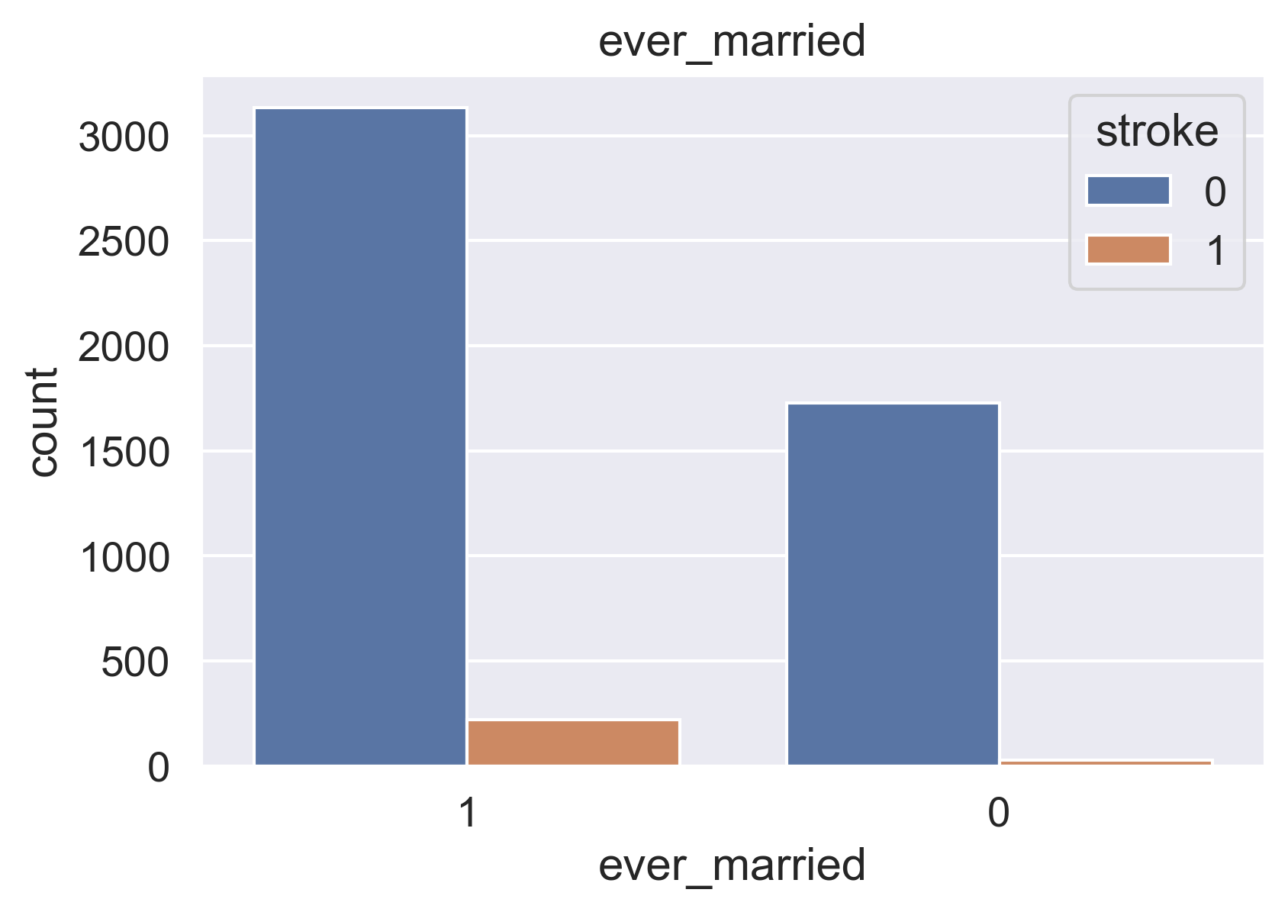
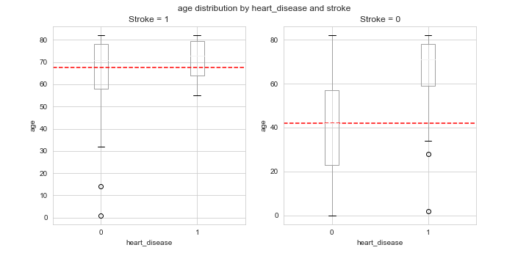
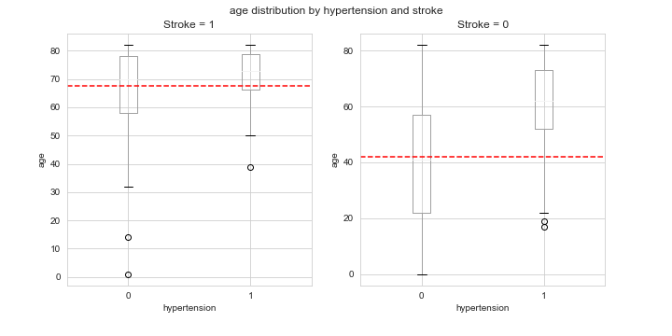
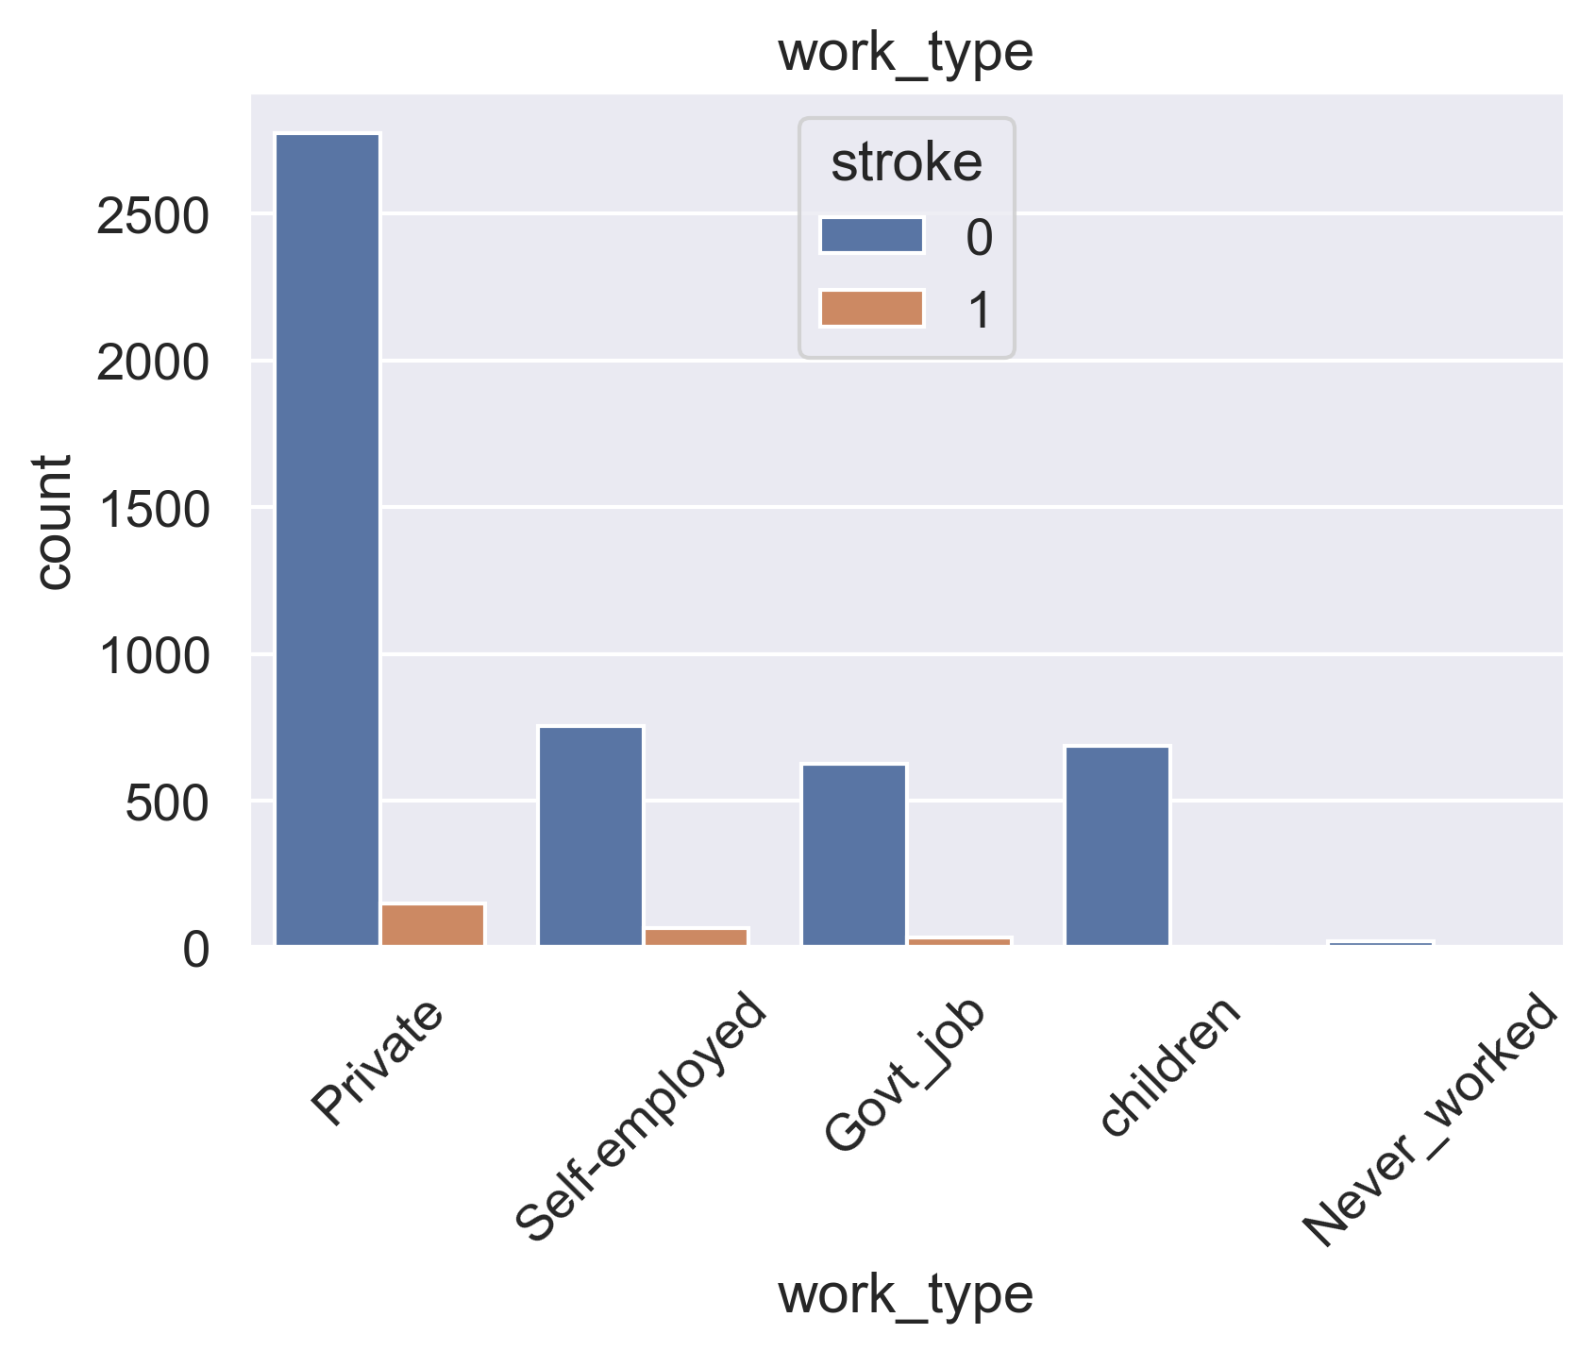
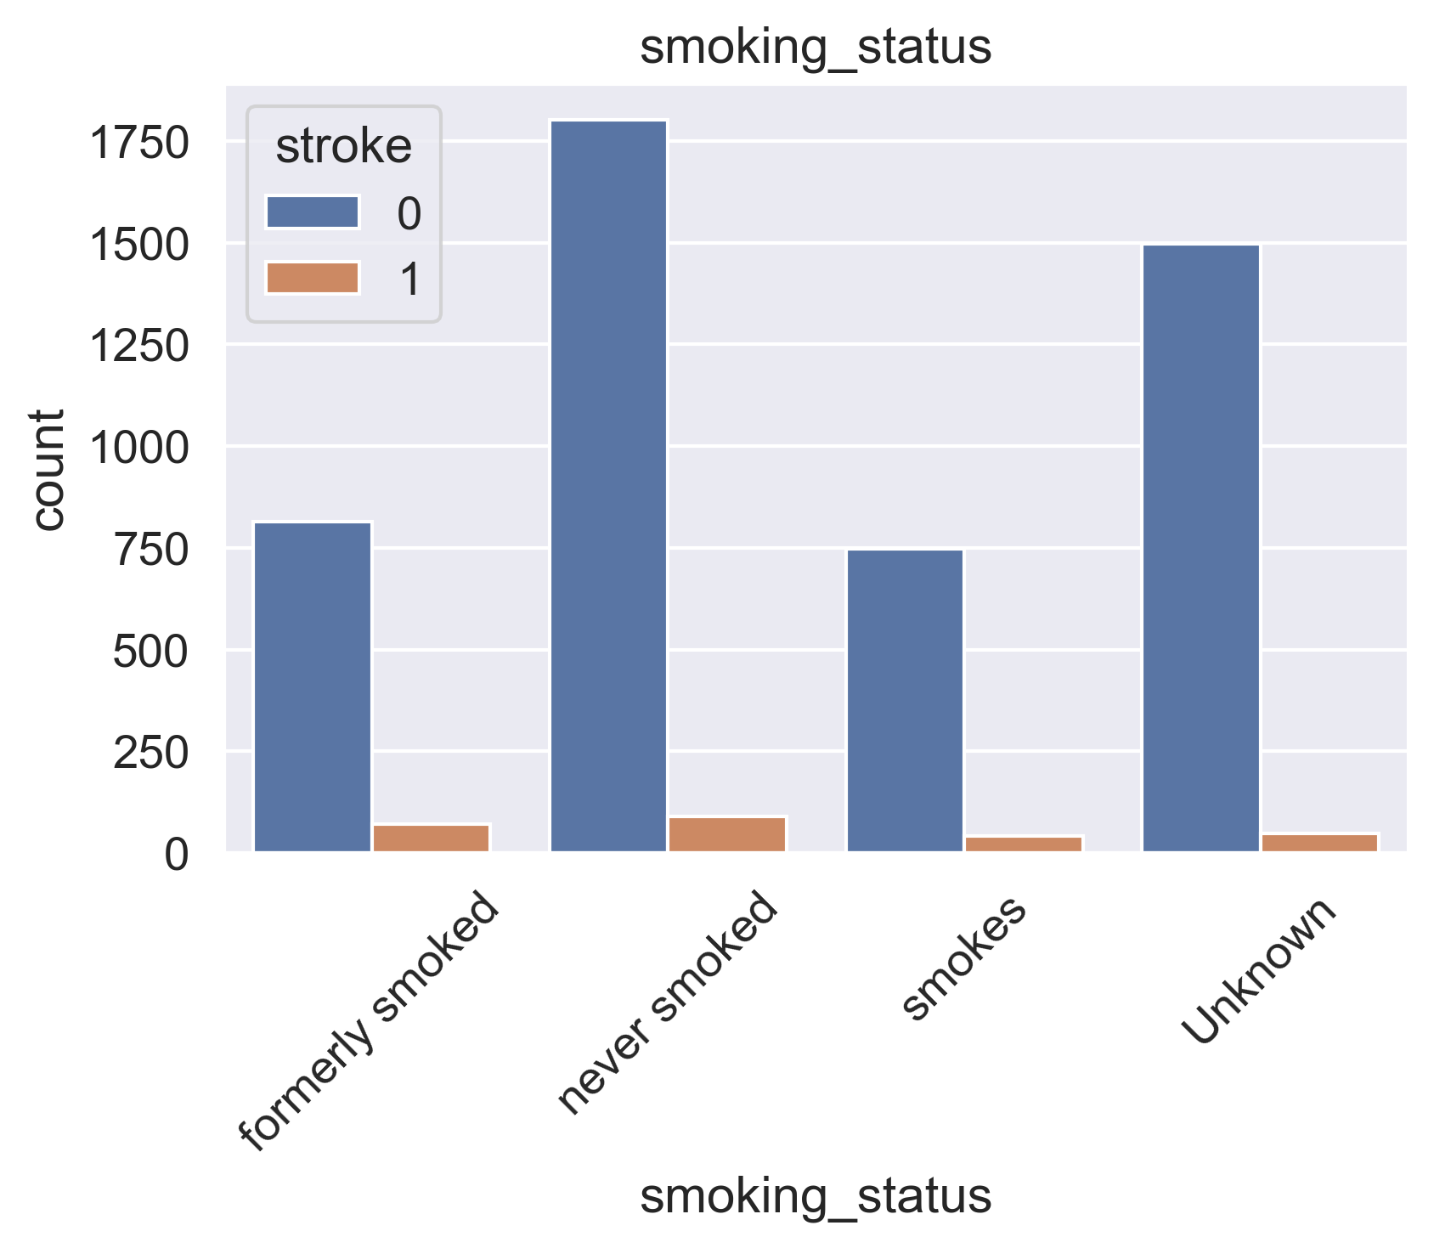
Exploratory Data Analysis: Categorical Variables
 | Project Outline |  | Methodology & Tools |  | Data Preparation & Analysis |  | Recommendations |  | App & Dashboard
Medical History
Individuals with a medical history who experienced a stroke tended to have a higher average age.
Demographic and Social Status
Life Style
The factors that account for the highest proportion of stroke occurrence include being married, never smoking, female gender, living in an urban area, and working in the private sector. However, it is important to analyze the stroke occurrence ratios within these groups.

Slide 10
Feature Engineering
 | Project Outline |  | Methodology & Tools |  | Data Preparation & Analysis |  | Recommendations |  | App & Dashboard
Feature engineering improves machine learning by creating useful features from raw data. Techniques like binning, one-hot encoding, and feature selection help models capture patterns and relationships in the data.
One-Hot Encoding
If a variable has only two unique values, we can assign 0 or 1 to each value. For variables with multiple unique values we can use one-hot encoding to create binary features for each unique value.
Binning
We created three new feature columns in our dataset: age_bin, glucose_bin, and bmi_bin. Age_bin has 10-year intervals, glucose_bin indicates whether a person has diabetes or not, and bmi_bin indicates whether a person is obese or not.
Feature Selection
To analyze the relationship between the target variable and numerical variables, we calculate their correlation coefficients. For categorical variables, we use chi-square statistics to determine the significance of p-values.

Slide 11
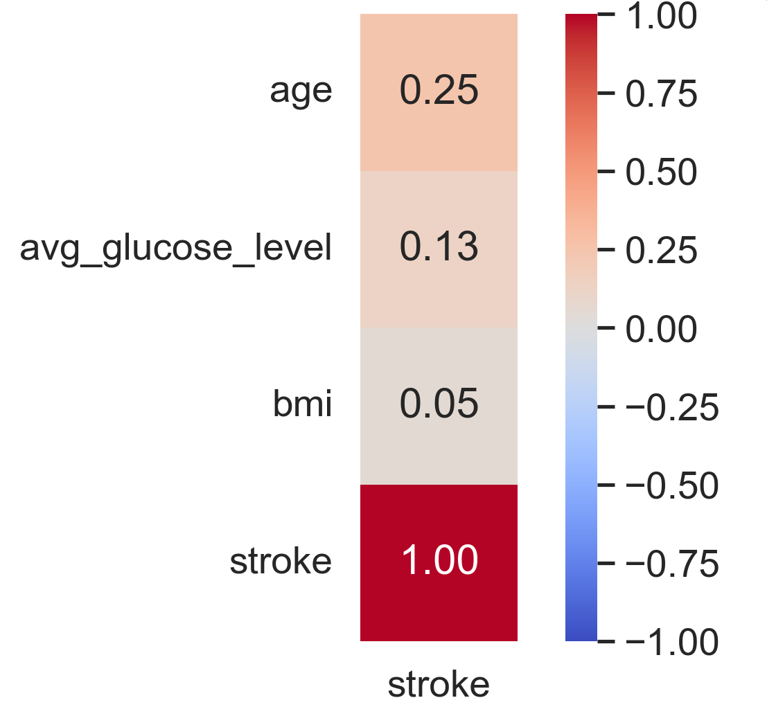
Feature Engineering
 | Project Outline |  | Methodology & Tools |  | Data Preparation & Analysis |  | Recommendations |  | App & Dashboard
Feature Selection
To analyze the relationship between the target variable and numerical variables, we calculate their correlation coefficients. For categorical variables, we use chi-square statistics to determine the significance of p-values.
Correlation Plot (Numerical Variables)
Chi-Square Statistics Table (Categorical Variables)
We may consider removing the 'gender' and 'Residence_type' variables due to the lack of significance on the target variable.
Features | Chi-Square | P-value
gender | 0.34 | 0.5598
hypertension | 81.57 | 0.0000
… | … | …
Residence_type | 1.07 | 0.2998
smoking_status | 29.23 | 0.0000
… | … | …
The correlation coefficients for the numerical variables fall in the range of 0 to 0.25.
This is a weak correlation, even though it does not necessarily imply no relationship.

Slide 12
Feature Engineering
 | Project Outline |  | Methodology & Tools |  | Data Preparation & Analysis |  | Recommendations |  | App & Dashboard
Target Variable |  | Original variables |  | Dropped Variables |  | Created Variables
Medical History
10 Year Interval
stroke
hypertension
age
age_groups
heart_disease
Obesity
bmi
bmi_groups
Weak Correlation
Social Status
Diabetes
ever_married
avg_glucose_level
glucose_groups
work_type
id
gender
Insignificant P-values
Life Style
smoking_status
Residence_type

Slide 13
Modeling
 | Project Outline |  | Methodology & Tools |  | Data Preparation & Analysis |  | Recommendations |  | App & Dashboard
Data Preparation
Removing unnecessary variables Handling missing values Encoding categorical variables
Data Splitting
Splitting data into training and testing sets
Model Selection
Testing multiple classifier models Evaluating accuracy scores to narrow down options
Model Comparison
Comparing top models using confusion matrices. Analyzing feature importances to understand variable importance
Model Evaluation
Creating ROC-AUC Curve. Performing cross-validation to detect overfitting. Selecting final model based on evaluation results
Candidate Models
Linear models: Logistic Regression, Linear SVC, Perceptron, Stochastic Gradient Descent Non-linear models: Support Vector Machines, K-Nearest Neighbors, Decision Tree, Naive Bayes Non-linear / Ensemble model: Random Forest

Slide 14
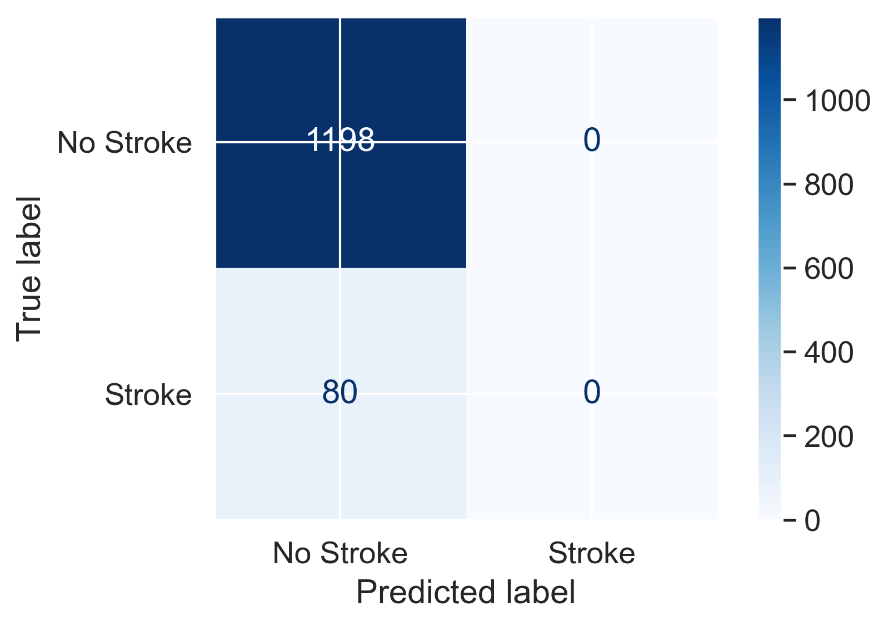
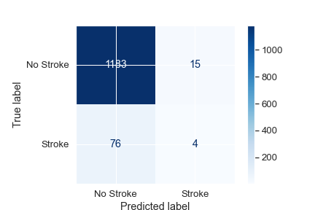
Prediction
 | Project Outline |  | Methodology & Tools |  | Data Preparation & Analysis |  | Recommendations |  | App & Dashboard
Accuracy by Classifier Models
Logistic Regression
Random Forest
Model | Accuracy Score
Logistic Regression | 93.74
Support Vector Machines | 93.74
Linear SVC | 93.74
Perceptron | 93.74
Stochastic Gradient Decent | 93.74
KNN | 93.66
Random Forest | 92.57
Decision Tree | 92.02
Naïve Bayes | 36.07
 | Precision | Recall | F1-Score
No Stroke | 0.94 | 1.00 | 0.97
Stroke | 0.00 | 0.00 | 0.00
 | Precision | Recall | F1-Score
No Stroke | 0.94 | 0.99 | 0.96
Stroke | 0.21 | 0.05 | 0.08
* Logistic Regression: Linear Classification
* Random Forest: Non-linear Classification

Slide 15
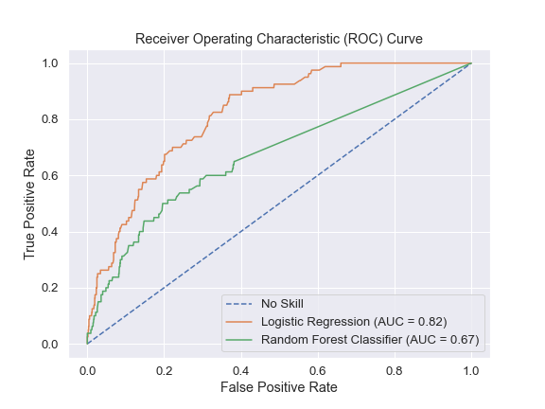
Prediction
 | Project Outline |  | Methodology & Tools |  | Data Preparation & Analysis |  | Recommendations |  | App & Dashboard
ROC – AUC Curve
ROC-AUC curve allows us to visually inspect the model's trade-off between sensitivity and specificity and to compare the different models’ performance. Logistic Regression model’s higher AUC-ROC score indicates a better ability to distinguish between positive and negative classes.
Confusion Matrix: Logistic Regression
Logistic Regression
The model fails to correctly predict the minority class due to the imbalance in the target variable.
 | Precision | Recall | F1-Score
No Stroke | 0.94 | 1.00 | 0.97
Stroke | 0.00 | 0.00 | 0.00

Slide 16
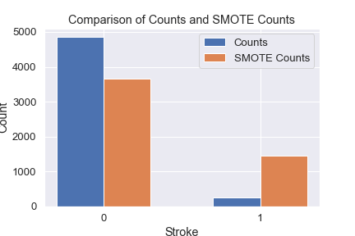

Final Model
 | Project Outline |  | Methodology & Tools |  | Data Preparation & Analysis |  | Recommendations |  | App & Dashboard
SMOTE: Upsampling
Before SMOTE
After SMOTE
We created synthetic data points of the minority class.
 | Stroke (1) | No Stroke (0)
Original Data | 249 (5%) | 4,860 (85%)
SMOTE Data | 1,464 (29%) | 3,662 (71%)
 | Precision | Recall | F1-Score
No Stroke | 0.94 | 1.00 | 0.97
Stroke | 0.00 | 0.00 | 0.00
 | Precision | Recall | F1-Score
No Stroke | 0.94 | 1.00 | 0.97
Stroke | 0.62 | 0.06 | 0.11
* After SMOTE, logistic regression still scored the highest accuracy 93.90, +0.26 compared to the model before SMOTE.

Slide 17
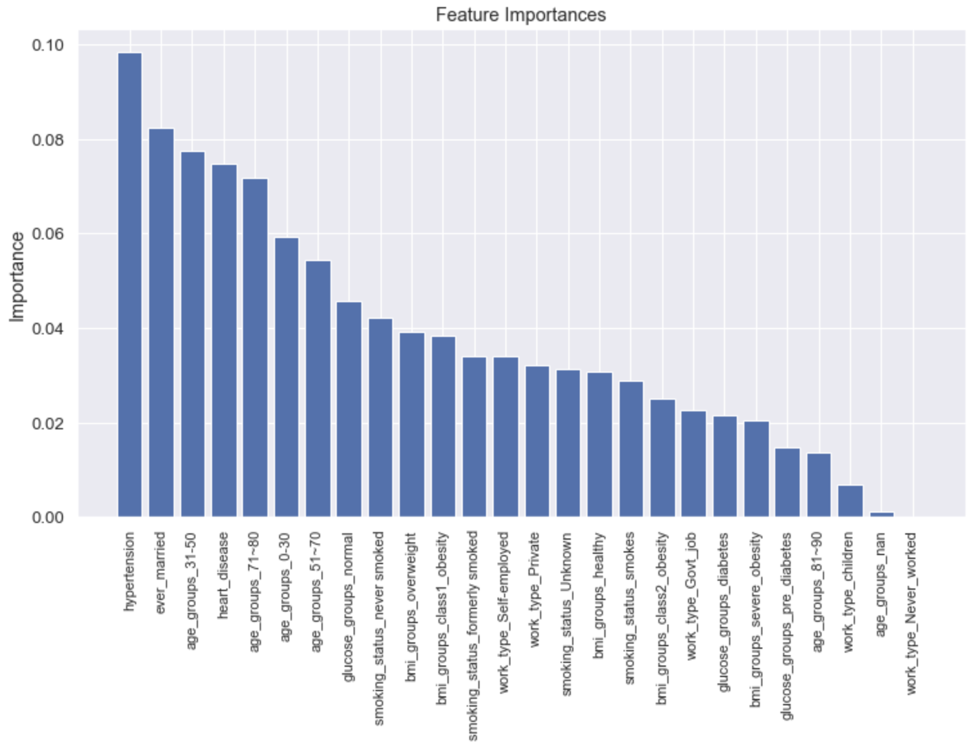
Final Model
 | Project Outline |  | Methodology & Tools |  | Data Preparation & Analysis |  | Recommendations |  | App & Dashboard
Final Model Summary
Model | Logistic Regression
Target Variable | Stroke (Yes, No)
Input Variable | hypertension, heart_disease, ever_married, work_type, smoking_status, age_groups, bmi_groups, glucose_groups
Accuracy | 93.90
Major Coefficients | Hypertension ever_married age_group_31~50 heart_disease age_group_71~80
Logistic Regression Coefficients (sorted by absolute value)
Logistic Regression Coefficients shows how much each feature contributes to the prediction of the target variable.

Slide 18
Final Model
 | Project Outline |  | Methodology & Tools |  | Data Preparation & Analysis |  | Recommendations |  | App & Dashboard
Stroke Data
5,110 Observations
11 Input Variables, 1 Output Variable
Preprocessing
Feature Engineering
From 11 to 8 Input Variables
Modeling
Nulls, outliers, anomalies
Upsampling
Binning / Categorizing
One-hot Encoding
Feature Selection
Linear Classifier
Non-Linear Classifier
Age, Obesity, Diabetes Group
SMOTE
Feature Importance
P-value
Correlation
Logistic Regression
Random Forest
Imbalanced data ( Stroke Case: 5%)
Synthetic observation of the minority class
Major Features: Individuals who are married, aged 31-50 or 71-80, and have heart disease
Computational efficiency
Model performance (ROC-AUC)
Final Model: Logistic Regression | Stroke Predictive Accuracy: 93.90

Slide 19






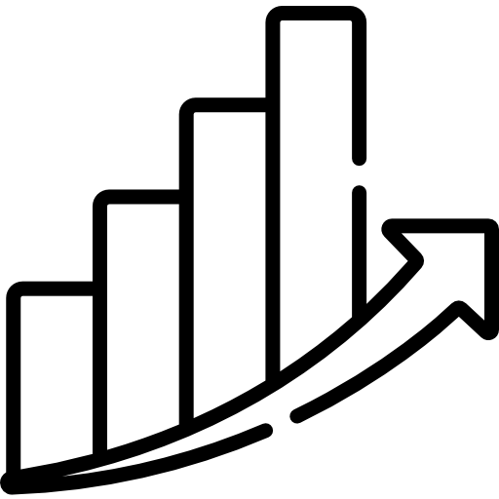
Recommendations
 | Project Outline |  | Methodology & Tools |  | Data Preparation & Analysis |  | Recommendations |  | App & Dashboard
Current Model |  | Model Improvement |  | Model Fine-Tuning |  | Business Implementation
Model: Logistic Regression Predictive Accuracy: 93.74 Features: 8 Feature Importance Hypertension Marital status Age Group Heart Disease History |  | Hyperparameter tuning (Grid search, Random search, Bayesian optimization…) Ensembling (bagging, boosting…) Collect more data (stroke case) to resolve imbalance |  | Monitoring performance Regular retraining Updating the algorithm Regular code reviews Mitigating overfitting |  | Investment in app development based on our product prototype Extra health care services for cohorts that are more likely to get heart strokes
Notes:
Model
Accuracy Score
Logistic Regression
93.74
Support Vector Machines
93.74
Linear SVC
93.74
Perceptron
93.74
Stochastic Gradient Decent
93.74
KNN
93.66
Random Forest
92.57
Decision Tree
92.02
Naïve Bayes
36.07

Slide 20
















UI/UX MOCKUPs
 | Project Outline |  | Methodology & Tools |  | Data Preparation & Analysis |  | Recommendations |  | App & Dashboard
1
How are you feeling?
How are you feeling?
2
STROKE SCORE
HEART RATE
4
B/E/F/A/S/T
Enter Symptoms directly
Calculate the stroke score and initiate alert
Capture body profile and document family history
Document body measurements and physical activities
Consult with a doctor and prescribe medication
Utilize motion recognition on a mobile phone to diagnose a stroke
CALL 911
50
BALANCE
HIGH 145
LOW 85
AVG 120 (NORMAL)
Click & lift your phone to test
EYES
Keep watching
Click & see the number to test
FACE
3
BODY PROFILE
ACTIVITY LOG
Click & take a photo to test
6
ARMS
AGE 52 YEARS
HEIGHT 178 CM
WEIGHT 90 KG
BMI 28.4
STROKE
CHECK LIST
Click & lift your phone to test
SPEECH
SYMPTOM
RECORDS
Click & record your voice to test
TIME
z
5
z

Slide 21


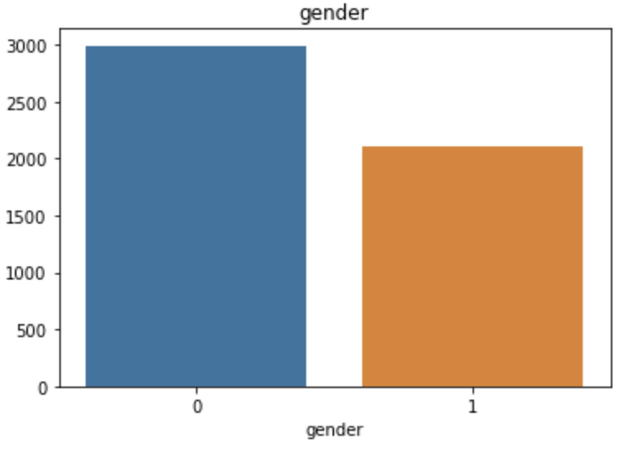
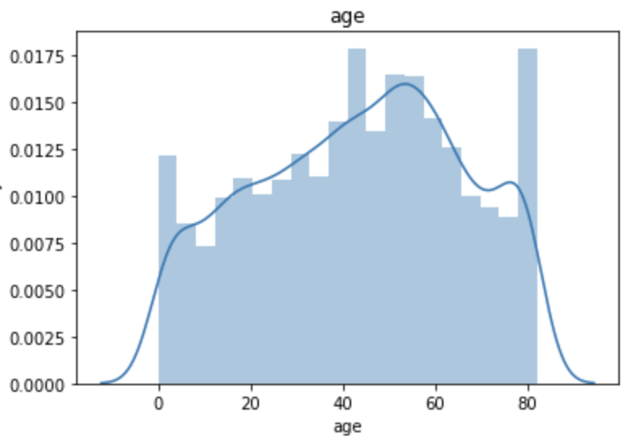
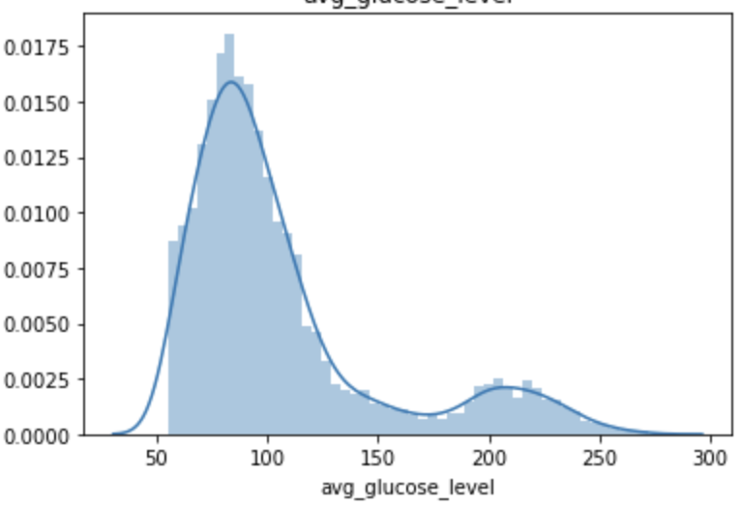
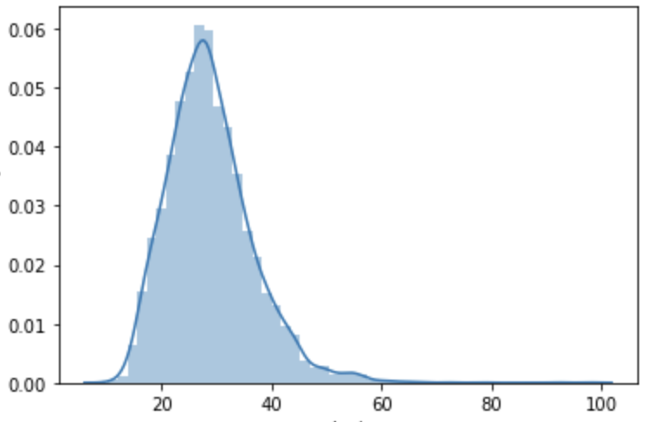

Stroke Analysis Dashboard
 | Project Outline |  | Methodology & Tools |  | Data Preparation & Analysis |  | Recommendations |  | App & Dashboard
Member’s Profile
This section presents the profiles of members who have used our stroke prediction service.
Day of Week
Date
Date (Compare to)
Fri, Sat, Sun
≈
≈
Gender
Age
2022/01/01 ~ 2022/12/31
2021/01/01 ~ 2021/12/31
Stroke Prediction
This section displays the key performance indicators (KPIs) for predicting stroke incidence.
Stroke Diagnosis
Analysis Accuracy
Glucose Level
BMI
Diabetes
Obesity
Model | Logistic Regression
Accuracy | 93.90 (+0.26)
Cross Validation | 95.13
Hypertension
Heart Disease
No Stroke
Stroke

Slide 22
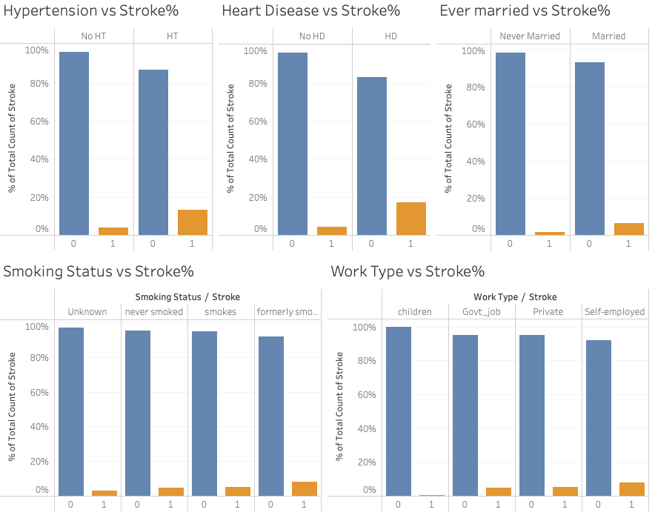
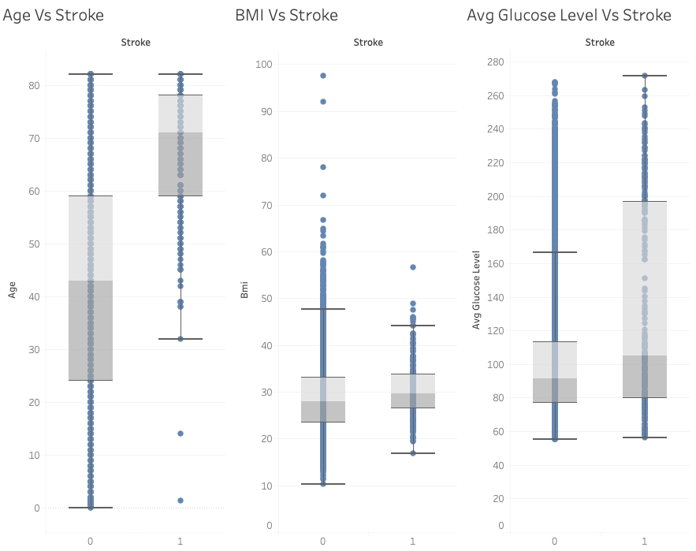
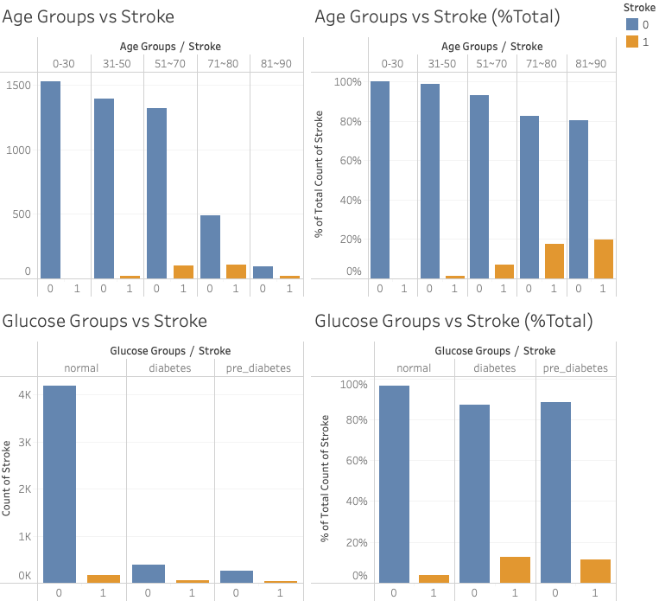
Stroke Analysis Dashboard
 | Project Outline |  | Methodology & Tools |  | Data Preparation & Analysis |  | Recommendations |  | App & Dashboard
Day of Week
Date
Date (Compare to)
This section presents categorical features that have a higher likelihood of being associated with an increased risk of stroke incidence.
Fri, Sat, Sun
≈
≈
2022/01/01 ~ 2022/12/31
2021/01/01 ~ 2021/12/31
Stroke Factor Analysis
This section indicates that age, average BMI, and glucose level are all significantly associated with the likelihood of suffering a stroke.
This section displays information on the total count and proportion of stroke occurrences.

Slide 23
Thank You

Slide 24
References
Dataset
https://www.kaggle.com/datasets/fedesoriano/stroke-prediction-dataset
Glucose-Level Interpretation
https://www.cdc.gov/diabetes/basics/getting-tested.html
BMI Interpretation
https://www.nhs.uk/common-health-questions/lifestyle/what-is-the-body-mass-index-bmi/
UI/UX Mockup Design
https://shakuro.com/blog/how-to-design-a-healthcare-app-that-makes-its-users-happier
Dashboard
https://samples.boldbi.com/solutions/healthcare/patient-experience-analysis-dashboard

